Slide 1
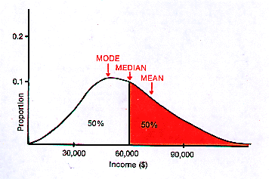
Descriptive Statistics

Slide 2
Data Description and Visualization
Why describe data?
Determine if our sample reflects the population of interest
Identify outliers
Obtain metrics necessary for inferential tests
Understand the distribution of our data values – test for normality
Identify the type of statistical test to run

Slide 3
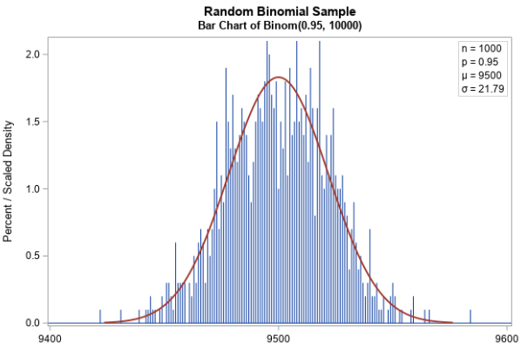
Data Description and Visualization
We can examine our data and run statistical tests to see if the distribution approximates a normal curve.
Typically, we start by visualizing our data

Slide 4
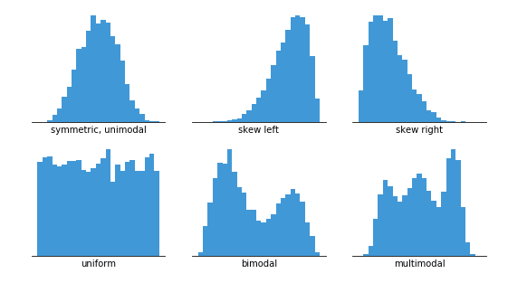
Histogram Basics
Continuous data are most commonly visualized using Histograms
Frequency of Observations
Data Values

Slide 5
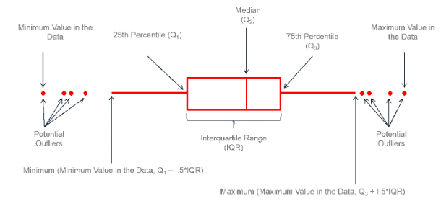
Box and Whisker Basics

Slide 6
Metrics to Describe data distribution
Data and their associated distributions can be described in four primary ways…
Central Tendency (mean, median, mode)
Variability (standard deviation, variance, quantiles)
Skew
Kurtosis (Peakedness)

Slide 7
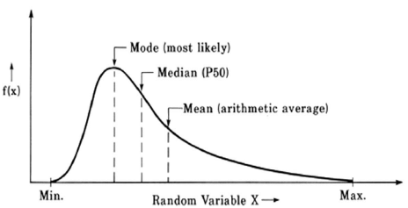
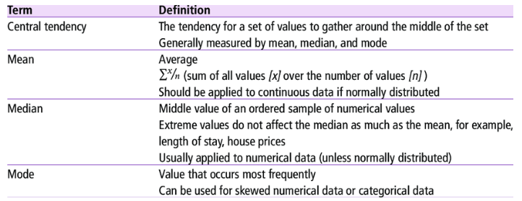
Central Tendency
=mode(array)
Watch out, excel will return the first mode only
Mean Median Mode
=average(array)
=median(array)
No formula, just a process …. Rank order observations then find the middle

Slide 8

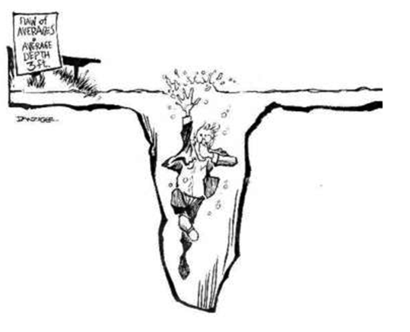
More on the MEAN…
Sample mean is the measure of central tendency that best represents the population mean
Mean is VERY sensitive to extreme scores that can “skew” or distort findings
For perspective, the national average wage in 1985 was $16,822

Slide 9
Beyond the MeDian - Percentiles
Percentiles are used to define the percent of cases equal to and below a certain point on a distribution
The median IS the 50th percentile……half of all observations fall at or below this value
But lots of other percentiles are also important

Slide 10
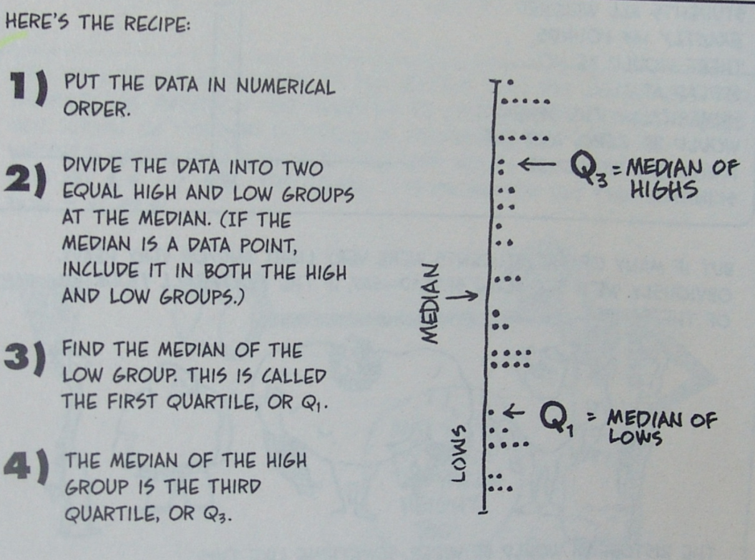
A little about Percentiles…
Quartiles are a common percentile used to represent the value below which
25% (Q1 or first quartile)
and
75% (Q3 or third quartile)
of all other measured
values fall.

Slide 11
WHEn TO USE WHAT
Central tendency
Use the Mode when the data are categorical:
Mode: is the value that occurs most frequently in your data
This is because having the same value occur for
measurements with many significant digits is highly unlikely
Use the Median when you have extreme scores:
Median: is simply the value that falls in the middle of
all your data
Use the Mean the rest of the time

Slide 12
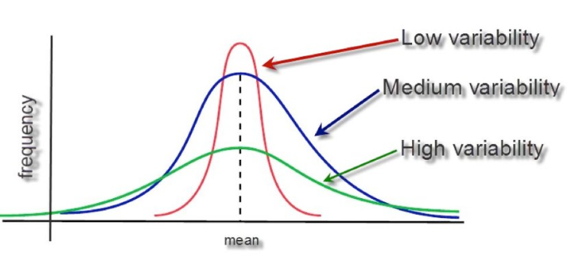


Variability
=var(array)
Standard Deviation Variance Range
=stdev(array)
=max(array) - min(array)
R = h – l

Slide 13
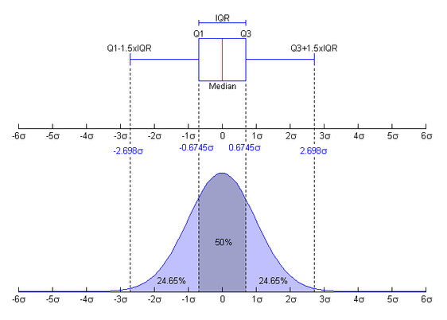
Percentiles are useful for spread too…
You can use percentiles to get a feel for how spread out the data is and where most of your observations are contained:
Inter-quartile range (IQR) = Q3 – Q1

Slide 14
Identifying outliers
An outlier is an observation that lies outside the overall pattern of a distribution (Moore and McCabe 1999).
Usually, the presence of an outlier indicates some sort of problem. (e.g. an error in measurement or sample selection).
But they may also be an indicator of novel data or identification of unique and exciting observations.

Slide 15
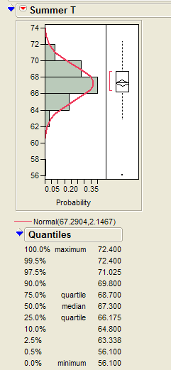
Identifying outliers
The first and third quantiles (Q1 and Q3) are often calculated to identify outliers
One method for systematically identifying outliers uses:
Q1- (1.5 X the inter-quartile range)
Q3 + (1.5 X the inter-quartile range)
Others identify outliers as any values below the 0.5th or above the 99.5th percentile
In EXCEL use =percentile(array, k)
returns the observation value for percentile k, where k is the 0 to 1 percentile

Slide 16
WHEn TO USE WHAT
Variability
Use the Standard deviation (SD) in most cases
SD quantifies how far, on average, each observation is from the mean.
The larger the SD, the more highly variable your data.
Use range (R) when describing predictive models
R is simply the maximum minus the minimum value in your data set
R is important when modeling or making predictions, since your algorithms are valid only over the range of values used to calibrate your predictive model
Use the IQR to identify and test potential outliers in your data.

Slide 17
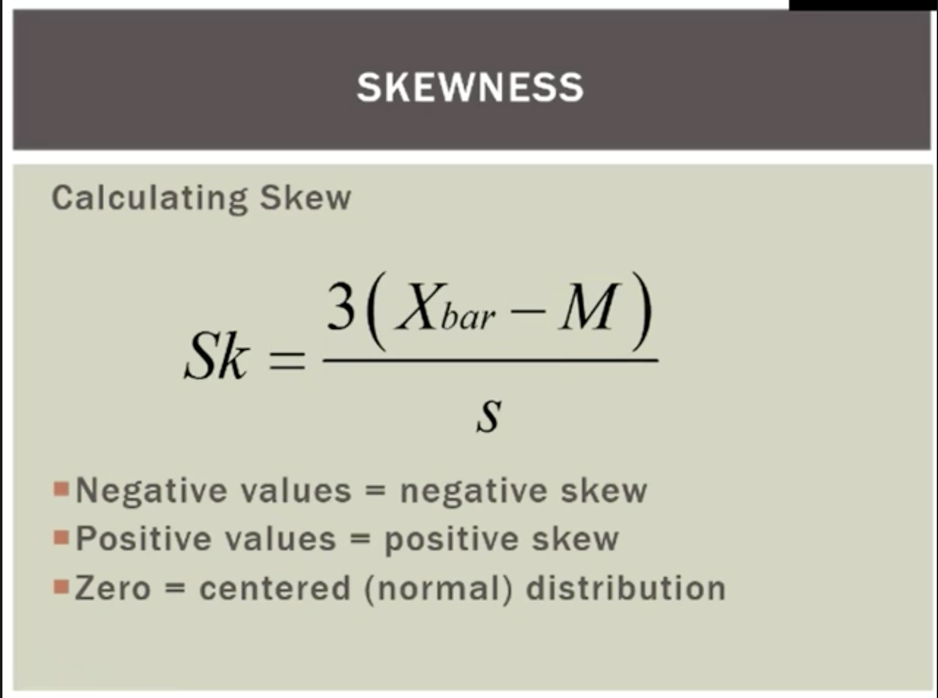
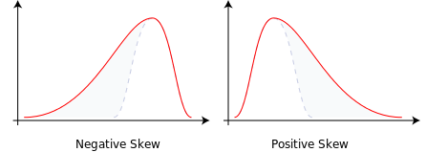
Skewness: This metric quantifies how balanced (symmetrical) your
distribution curve is

Slide 18
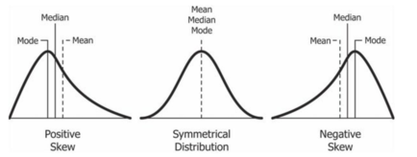
A normal distribution will have its mean and median values located somewhere near the center of its range
Notes:
Page 31

Slide 19
Skew of this peak away from center is common when extreme values pull the median away from the mean.
Notes:
Page 31

Slide 20
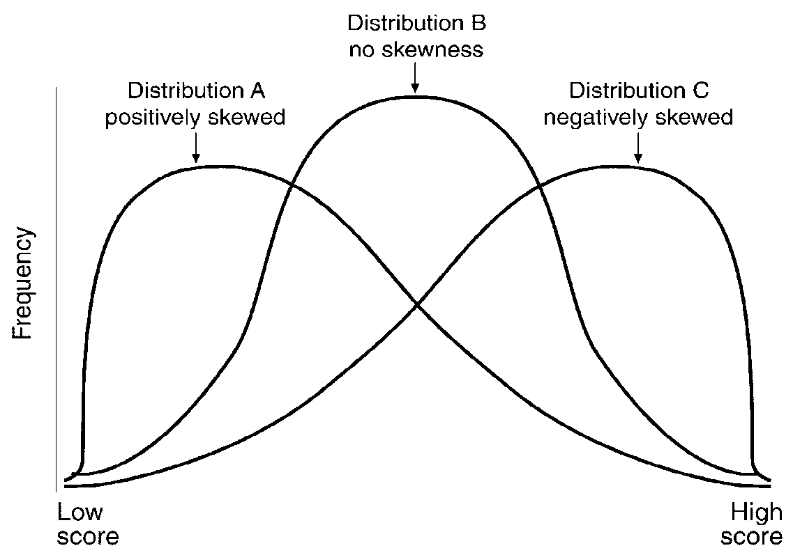
Skewness
Positive & Negative Skewness……. Does your bell curve lean?
Negative Skew:
the “slide” takes you in a negative direction
The mean is smaller than the median (which is why the slide is being pulled to lower values)
Positive Skew:
the “slide” takes you in a positive direction
The mean is bigger than the median (which is why the slide is being pulled to higher values
X_{bar}>M
X_{bar}<M

Slide 21
Mean
Median
Standard deviation
In excel use the function: =skew(array)
Notes:
https://www.investopedia.com/terms/s/skewness.asp
Pearson’s second coefficient of skewness, or Pearson median skewness, subtracts the median from the mean, multiplies the difference by three, and divides the product by the standard deviation.

Slide 22
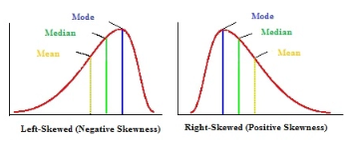
Skewness – Significant?
=skew(array)
To determine if this deviation from zero in the skew statistic is likely a significant departure from normality, compare it to the standard error of skew (ses)
If the skew you have calculated is more than 2 times the ses, then you likely have significant skew, which means you have nonnormal
data and should consider a nonparametric test for your statistical analyses
SES= standard error of skew

Slide 23
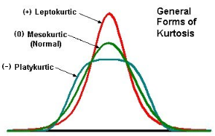
KURTOSIS
Kurtosis is simply a measure of how pointy or flat the peak of your distribution curve is
Any deviation from a bell shape, with the peak either too flat (platykurtic) or too peaked (leptokurtic), suggests that your data are not normally distributed
Notes:
Page 29

Slide 24
Peakedness – Kurtosis
Positive values = Leptokurtic
Zero = Mesokurtic – normal (bell-shaped)
Negative values = Platykurtic
In excel use the function: =kurt(array)

Slide 25
Peakedness Significant?
To determine if this deviation from zero in the kurtosis statistic is likely a
significant departure from normality, compare it to the standard error of
kurtosis (sek)
If the kurtosis you have calculated is more than twice the sek, you likely have nonnormal data and should consider a nonparametric
test for your statistical analyses.
sek

Slide 26
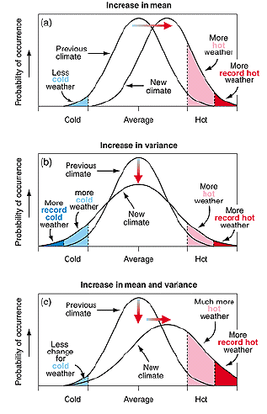
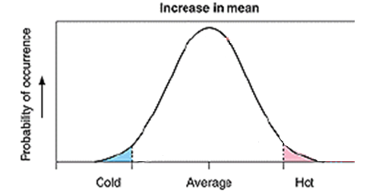
Some Visual Examples
How can climate change?
Change in central tendency

Slide 27
Some Visual Examples
How can climate change?
Change in spread and shape

Slide 28
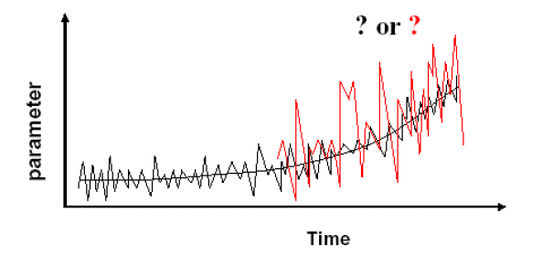
Some Visual Examples
How can climate change?
Change in BOTH

Slide 29

Data Distributions
There are various types of data distributions, each with its own unique properties and implications.
In nature, most data are normally distributed.
The central limit theorem (CLT) states that the distribution of sample means approximates a normal distribution as the sample size gets larger, regardless of the population's distribution.
Notes:
In simpler terms, this notation communicates that when you take a sufficiently large sample from a population (where �n is sufficiently large), the distribution of sample means will resemble a normal distribution with a mean equal to the population mean �μ and a standard deviation equal to the population standard deviation �σ divided by the square root of the sample size �n.

Slide 30
Why do we care if our data is normal?
The math ‘under the hood’ of many analyses expects that data is normally distributed - if it isn’t, you’ll still get an answer, but it won’t actually be saying what you think it is saying.

Slide 31
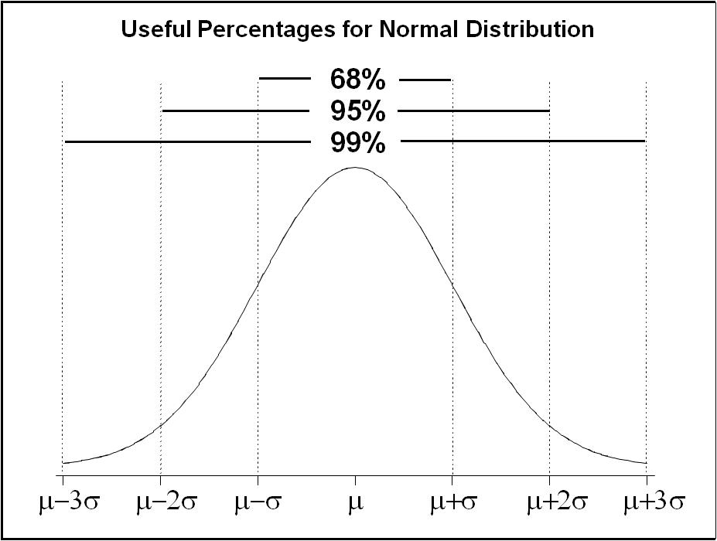
Why do we care about skew and kurtosis?
Because many statistical analyses assume a normal distribution of the data, testing for normality must always be a precursor to any analysis.
Normally Distributed Data is:
Unimodal (one mode)
Symmetrical (no SKEW)
Bell Shaped (no KURTOSIS)
Mean, Mode and Median are all centered
Asymptotic (tails never reach 0)

Slide 32
Why do we care about skew and kurtosis?
We can examine all of these different descriptors individually, but the easiest and most complete way to test for normality is to
test the goodness of fit
for a normal distribution.

Slide 33
What to do about non-normal data?
Once you discover that your data is non-normal you have several options:
Analyze and potentially remove outliers
Transform the data mathematically
Conduct non-parametric analyses

Slide 34
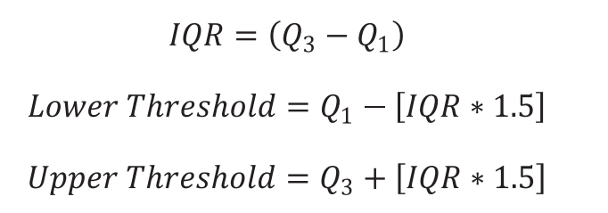
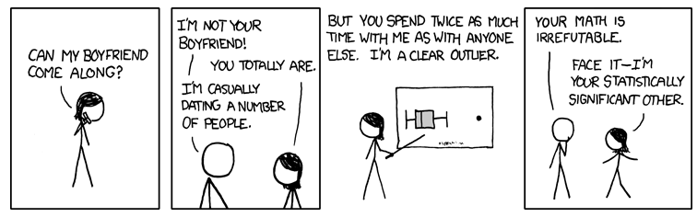
Outliers?
How to find outliers:
Outlier box plots (visual) use the IQR * 1.5 threshold
percentiles (often < 2.5th or above 97.5th percentile)
These can help identify potential outliers but do not justify their removal.
Sometimes outliers are REAL, CORRECT (although extreme) observations that we are truly interested in.
We can only remove outliers if we know the data is incorrect

Slide 35
Working with non-normal Data
Transformations:
To transform your data, apply a mathematical function to each observation, then use these numbers in your statistical test.
There are an infinite number of transformations you could use, but it is better to use one common to our field.

Slide 36
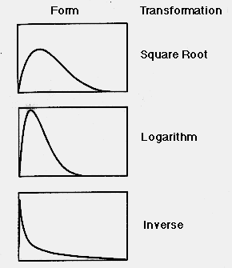
Working with non-normal Data
Non-normal data happens….. Especially with counts, percents, rare events.
Common transformations in our field:
square-root
log
Inverse
Rank

Slide 37
Square root Transformation
square-root transformation. This consists of taking the square root of each observation.
=SQRT(X)
If you apply a square root to a continuous variable that contains values negative values, decimals and values above 1, you are treating some numbers differently than others…..so a constant must be added to move the minimum value of the distribution to 1

Slide 38
Log Transformation
Many variables in biology have log-normal distributions
=LOG(X)
The logarithm of any negative number is undefined and log functions treat decimals differently than numbers >1, SO
a constant must be added to move the minimum value of the distribution to 1

Slide 39
Inverse transformation
Inverse transformation. This consists of taking the inverse (X⁻¹) of a number.
=1/X or
=(X)^⁻¹
Tends to make big numbers small and small numbers big a constant must be added to move the minimum value of the distribution to 1
Notes:
Data transformations are valuable tools, offering man benefits. However, they should be used appropriately, in an informed manner. Too many statistical texts gloss over this issue, leaving researchers ill-prepared to utilize these tools appropriately. All of the transformations examined here reduce non-normality by reducing the relative spacing of scores on the right side of the distribution more than the scores on the left side.
However, the very act of altering the relative distances between data points, which is how these transformations improve normality, raises issues in the interpretation of the data. If done correctly, all data points remain in the same relative order as prior to transformation. This allows researchers to continue to interpret results in terms of increasing scores. However, this might be undesirable if the original variables were meant to be substantively interpretable (e.g., annual income, years of age, grade, GPA) because the variables become more complex to interpret due to the curvilinear nature of the transformations. Researchers must therefore be careful when interpreting results based on transformed data.
CONCLUSIONS AND OTHER DIRECTIONS
Four recommendations for researchers grow out of this discussion:
1. Always examine and understand data prior to performing analyses. To do less is to increase the chance of drawing incorrect conclusions.
2. Know the requirements of the data analysis technique to be used. As Zimmerman (1998) and others have pointed out, even nonparametric analyses, which are generally thought to be "assumption-free," can benefit from examination of the data.
3. Utilize data transformations with care--and never unless there is a clear reason. Data transformations can alter the fundamental nature of the data, such as changing the measurement scale from interval or ratio to ordinal and creating curvilinear relationships, thereby complicating interpretation. As discussed above, there are many valid reasons for utilizing data transformations, including improvement of normality, variance stabilization, and conversion of scales to interval measurement
4. Ensure that the variable is anchored at a place where the transformation will have the optimal effect. In the case of the three transformations discussed, the anchor point should be 1.0.

Slide 40
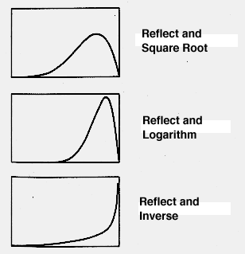
Reflecting Transformations
Each of these transformations can be adjusted for negative skew by taking the reflection
To reflect a value, multiply data by -1, and then add a constant to bring the minimum value back above 1.0
For example:
Square root sqrt (X) becomes sqrt ( [(X*-1)+c])
Log ln (X) becomes ln ([X*-1] +c)
Notes:
To reflect, one multiplies a variable by -1, and then adds a constant to the distribution to bring the minimum value back above 1.0.
All three transformations will have the greatest effect if the distribution is anchored at 1.0, and as the minimum value of the distribution moves away from 1.0 the effectiveness of the transformation diminishes dramatically.

Slide 41
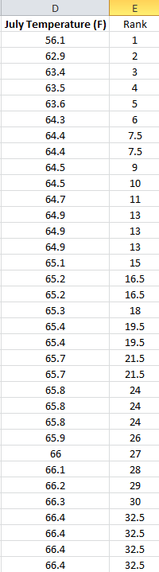
Rank Transform
Rank transformation require that your sort your data and then create a new data column assigning the rank to each observation
Ties report the mean rank
All data analyses are now run on the rank instead of the original data value
It is easiest to create a new column for ranks in your spreadsheet
=rank(value, array, 1)
Indicated to rank low to high

Slide 42
Transformation Rules to Live By
Transformations work by altering the relative distances between data points.
If done correctly, all data points remain in the same relative order as prior to transformation.
However, this might be undesirable if the original variables were meant to be substantively interpretable.
Therefore……..

Slide 43
Transformation Rules to Live By
Don’t mess with your data unless you have to
Are there true outliers? Remove and retest.
If you have to mess with it, make sure you know what you are doing….try different transformations to see which is best
Include these details in your methods
Back transform to original units for reports of central tendency and variability
Sometimes transformations don’t work…don’t panic, you will just get to run nonparametric tests
Notes:
Data transformations are valuable tools, offering man benefits. However, they should be used appropriately, in an informed manner. Too many statistical texts gloss over this issue, leaving researchers ill-prepared to utilize these tools appropriately. All of the transformations examined here reduce non-normality by reducing the relative spacing of scores on the right side of the distribution more than the scores on the left side.
However, the very act of altering the relative distances between data points, which is how these transformations improve normality, raises issues in the interpretation of the data. If done correctly, all data points remain in the same relative order as prior to transformation. This allows researchers to continue to interpret results in terms of increasing scores. However, this might be undesirable if the original variables were meant to be substantively interpretable (e.g., annual income, years of age, grade, GPA) because the variables become more complex to interpret due to the curvilinear nature of the transformations. Researchers must therefore be careful when interpreting results based on transformed data.
CONCLUSIONS AND OTHER DIRECTIONS
Four recommendations for researchers grow out of this discussion:
1. Always examine and understand data prior to performing analyses. To do less is to increase the chance of drawing incorrect conclusions.
2. Know the requirements of the data analysis technique to be used. As Zimmerman (1998) and others have pointed out, even nonparametric analyses, which are generally thought to be "assumption-free," can benefit from examination of the data.
3. Utilize data transformations with care--and never unless there is a clear reason. Data transformations can alter the fundamental nature of the data, such as changing the measurement scale from interval or ratio to ordinal and creating curvilinear relationships, thereby complicating interpretation. As discussed above, there are many valid reasons for utilizing data transformations, including improvement of normality, variance stabilization, and conversion of scales to interval measurement
4. Ensure that the variable is anchored at a place where the transformation will have the optimal effect. In the case of the three transformations discussed, the anchor point should be 1.0.

